Slide 1
Graph Theory
A graph is a set of nodes (a.k.a. vertices) where some pairs are connected by links (a.k.a. edges).
V = {A, B, C, D, E, F}
E = {(A,B), (B,C), (B,D), (C,E), (D,E), (E,F)}

Slide 2
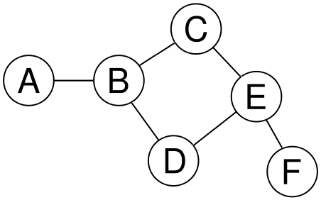
Undirected Graph
In an undirected graph, each edge links two vertices symmetrically.
(i.e. every edge is bi-directional)

Slide 3
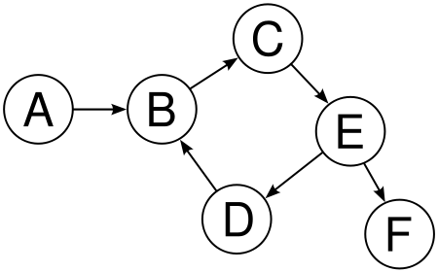
Directed Graph
In a directed graph, each edge links two vertices asymmetrically.

Slide 4
Edges list
The type of graph must be specified since the same lists of vertices is used for directed and undirected.
V = {A, B, C, D, E, F}
E = {(A,B), (B,C), (C,E), (D,B), (E,D), (E,F)}

Slide 5
Adjacency Matrix for a Directed Graph
The row labels are the sources, and the column headers are the destinations.
 | A | B | C | D | E | F
A | 0 | 1 | 0 | 0 | 0 | 0
B | 0 | 0 | 1 | 0 | 0 | 0
C | 0 | 0 | 0 | 0 | 1 | 0
D | 0 | 1 | 0 | 0 | 0 | 0
E | 0 | 0 | 0 | 1 | 0 | 1
F | 0 | 0 | 0 | 0 | 0 | 0

Slide 6
Adjacency Matrix for an Undirected Graph
 | A | B | C | D | E | F
A | 0 | 1 | 0 | 0 | 0 | 0
B | 1 | 0 | 1 | 1 | 0 | 0
C | 0 | 1 | 0 | 0 | 1 | 0
D | 0 | 1 | 0 | 0 | 1 | 0
E | 0 | 0 | 1 | 1 | 0 | 1
F | 0 | 0 | 0 | 0 | 1 | 0

Slide 7
Adjacency Matrix for an Undirected Graph
An undirected graph’s matrix will be symmetric about the major diagonal.
 | A | B | C | D | E | F
A | 0 | 1 | 0 | 0 | 0 | 0
B | 1 | 0 | 1 | 1 | 0 | 0
C | 0 | 1 | 0 | 0 | 1 | 0
D | 0 | 1 | 0 | 0 | 1 | 0
E | 0 | 0 | 1 | 1 | 0 | 1
F | 0 | 0 | 0 | 0 | 1 | 0

Slide 8
Adjacency Matrix Representation
Example: Undirected Graph G (V, E)
 | v | u | w
v | 0 | 1 | 1
u | 1 | 0 | 1
w | 1 | 1 | 0
u
v
w
Notes:
Note that the matrix is always symmetric for an undirected graph.

Slide 9
Adjacency List Representation
Each node (vertex) has a list of which nodes (vertex) it is adjacent.
u
node | Adjacency List
u | v , w
v | w, u
w | u , v
v
w

Slide 10
Adjacency Matrix Representation
Example: directed Graph G (V, E)
u
 | v | u | w
v | 0 | 1 | 1
u | 0 | 0 | 1
w | 1 | 0 | 0
v
w

Slide 11
Adjacency List Representation
u
node | Adjacency List
u | w
v | u, w
w | v
v
w
Note that here (v,w) and (w,v) are considered separate edges, while in an undirected graph they would be considered two ways to write the same edge and wouldn’t both be listed.

Slide 12
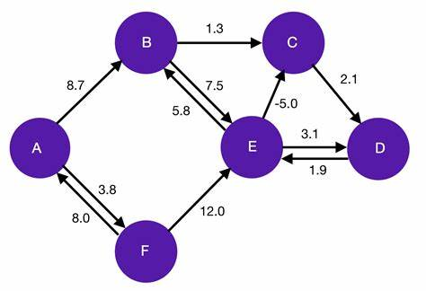
Weighted Graph
A weighted graph associates a value (weight) with every edge in the graph.

Slide 13
Adjacency Matrix for a Weighted Graph
 | A | B | C | D | E | F
A | 0 | 8.7 | 0 | 0 | 0 | 3.8
B | 0 | 0 | 1.3 | 0 | 7.5 | 0
C | 0 | 0 | 0 | 2.1 | 0 | 0
D | 0 | 0 | 0 | 0 | 1.9 | 0
E | 0 | 5.8 | -5.0 | 3.1 | 0 | 0
F | 8.0 | 0 | 0 | 0 | 12.0 | 0

Slide 14
Adjacency List for a Weighted Graph
node | Adjacency List
A | B(8.7), F(3.8)
B | C(1.3), E(7.5)
C | D(2.1)
D | E(1.9)
E | B(5.8), C(-5.0), D(3.1)
F | A(8.0), E(12.0)

Slide 15
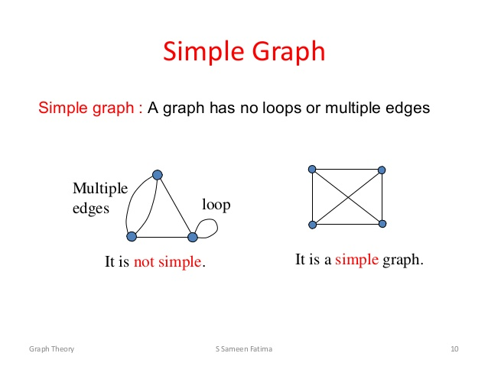
Simple vs Non-simple Graphs
A simple graph has no loops or multiple edges between nodes

Slide 16
Simple undirected graphs
A simple undirected graph never has multiple links between a pair of vertices.
Nor does it have loops.
5
7
3
11
8
2
9
10
Note that this is an unweighted graph.

Slide 17
Non-simple undirected graphs
A non-simple undirected graph never has multiple links between a pair of vertices.
Nor does it have loops.
5
7
3
11
8
2
9
10
Note that this is an unweighted graph.

Slide 18
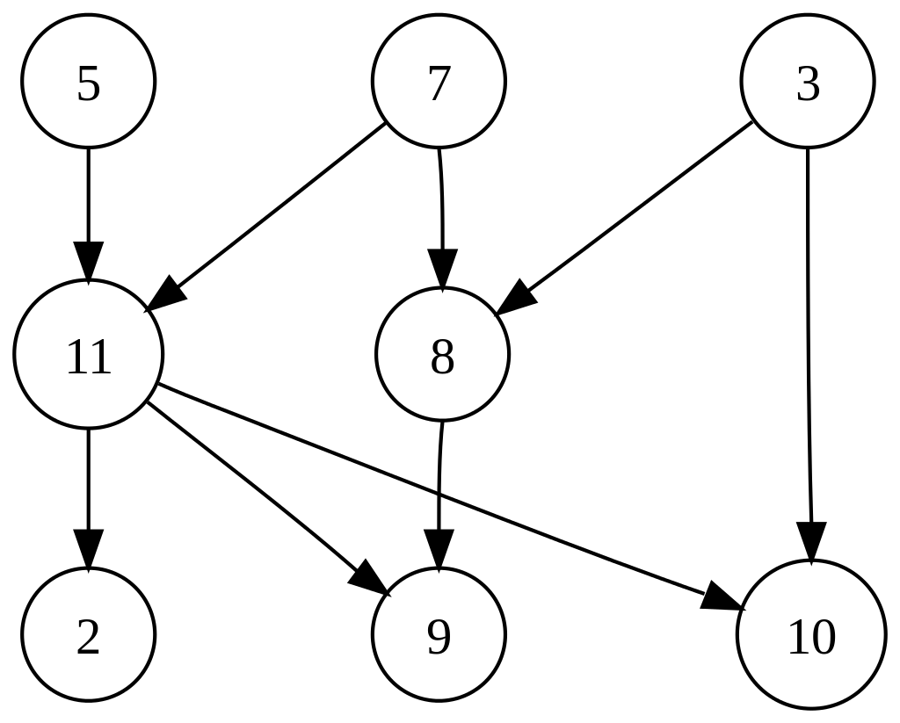
Simple directed graphs
A simple directed graph has no multiple arrows with same source and target nodes.
Note that this is an unweighted graph.

Slide 19
Non-simple directed graphs
A non-simple directed graph has multiple arrows with same source and target nodes.
Note that this is an unweighted graph.

Slide 20
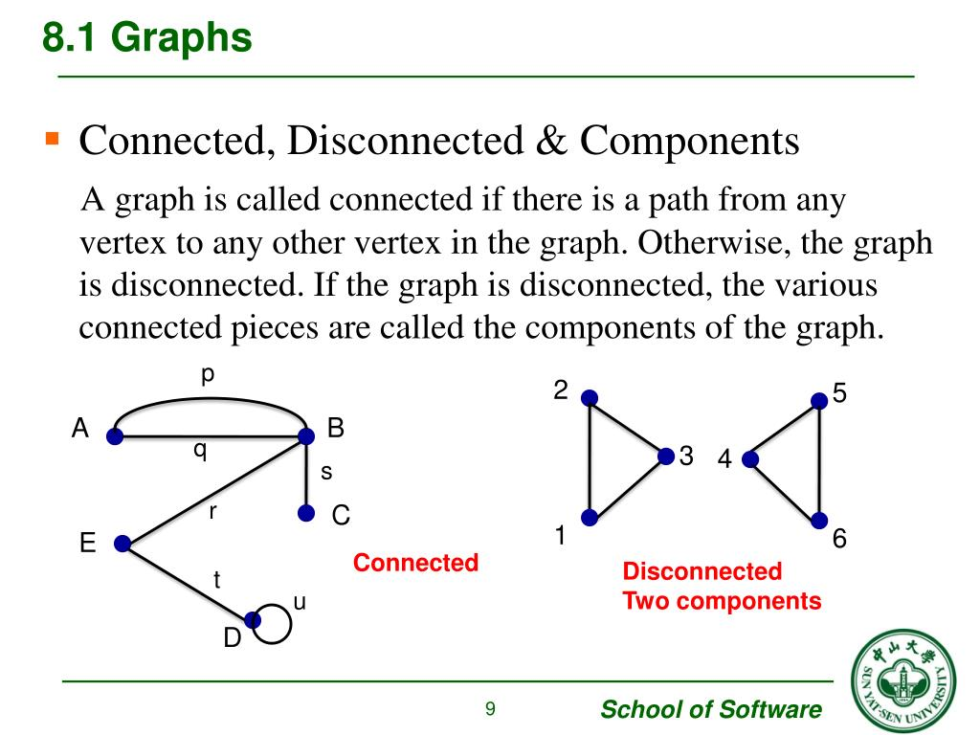
Connected/Disconnected Graphs & Components
A graph is connected if there is a path between any two vertices. In a disconnected graph the various connected pieces of a are called components of the graph.

Slide 21
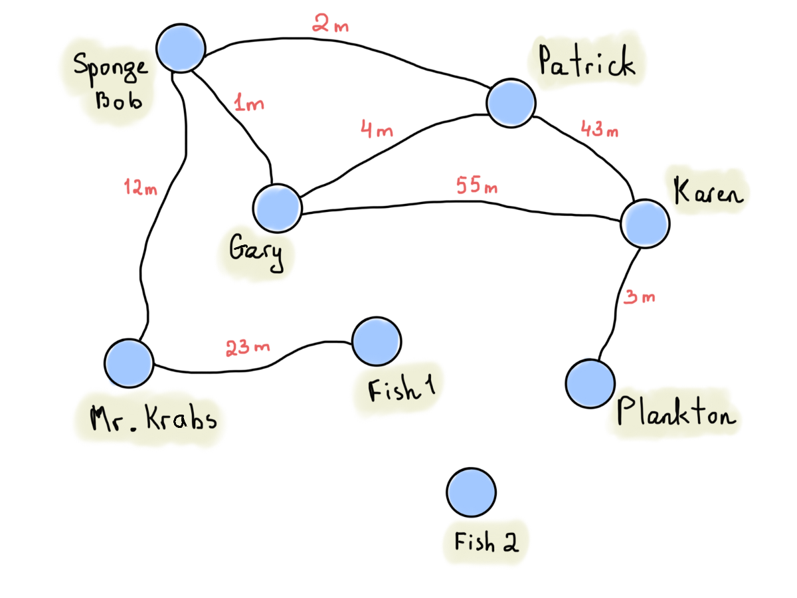

Practice classifying a graph
Classify the graph:
simple directed weighted cyclic
non-simple undirected unweighted acyclic
connected
disconnected

Slide 22
Practice classifying a graph
If Fish 2 was removed, it would be a simple connected graph, which is the type of graph we’ll typically study.

Slide 23
Walk definition
A walk is a sequence of edges which joins a sequence of vertices
Sponge Bob → Patrick → Sponge Bob → Gary → Karen)

Slide 24
Walk definition
A closed walk is a walk that starts and ends at the same vertex.
Sponge Bob → Patrick → Karen → Patrick → Sponge Bob

Slide 25
Trail definition
A trail is a walk in which all edges are distinct. Sponge Bob → Gary → Patrick → Sponge Bob → Mr. Krabs

Slide 26
Trail definition
A closed trail is known as a circuit. Sponge Bob → Patrick → Gary → Karen → Plankton → Gary → Sponge Bob

Slide 27
Path definition
A path is a trail in which all vertices are distinct (except perhaps the start and ending vertices).
Sponge Bob → Gary → Patrick → Karen

Slide 28
Cycle definition
A closed path is known as a cycle.
Gary → Patrick → Karen → Gary
A cycle contains a path, but is not itself a path.

Slide 29
Classifying Walks 1
Given a group of edges & nodes from a graph
i.e. possible to traverse?
Walk
edges distinct? (i.e. edges don’t repeat)
Trail
vertices distinct?
Path
start=end?
Cycle

Slide 30
Classifying Walks 2
Classifying Types of Walks
 | Edges may repeat | Vertices may repeat
Walk | yes | yes
Trail | no | yes
Path | no | no*
* Except the start and end can match

Slide 31
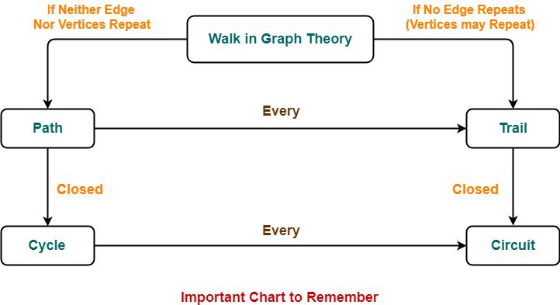
Classifying walk 3

Slide 32
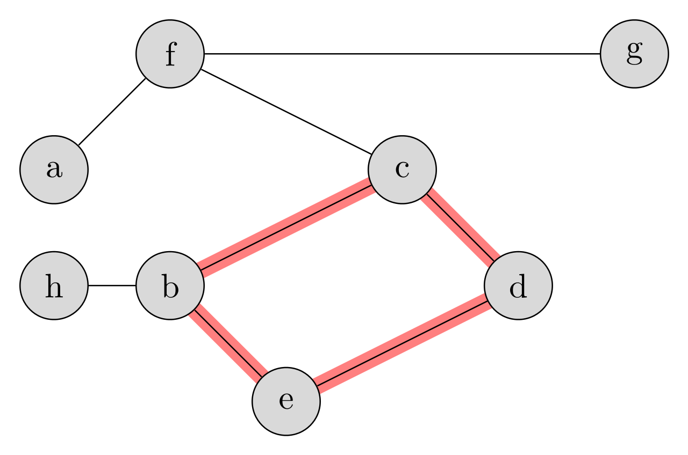
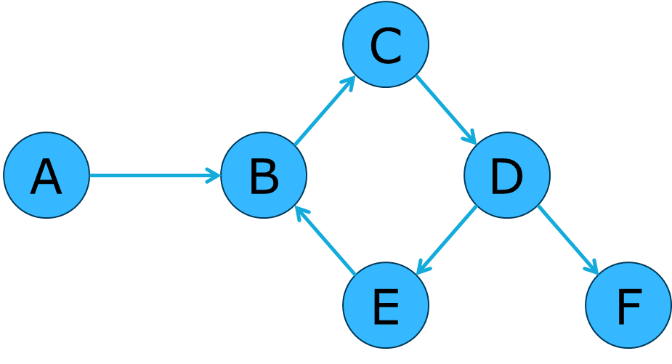
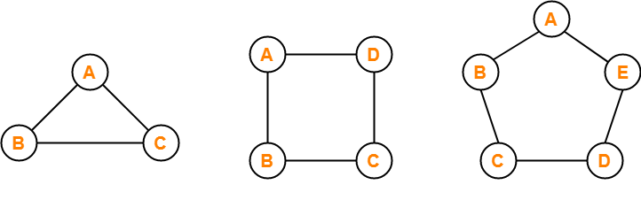
Cyclic Graphs and Cycle Graphs
A cyclic graph contains a cycle.
A circular graph is a cycle.
Notes:
A cycle/circular graph is a cycle. I.e. it contains one cycle, and that cycle traverses all of the vertices.

Slide 33
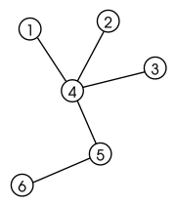
Cyclic Graphs and Cycle Graphs
An acyclic graph contains no cycles.
It’s also known as a tree.
Notes:
A cycle/circular graph is a cycle. I.e. it contains one cycle, and that cycle traverses all of the vertices.

Slide 34
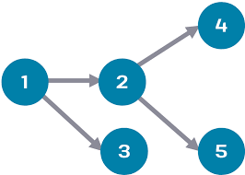
Cyclic Graphs and Cycle Graphs
Directed acyclic graphs (DAGs) have numerous scientific and computational applications.
Notes:
A cycle/circular graph is a cycle. I.e. it contains one cycle, and that cycle traverses all of the vertices.

Slide 35
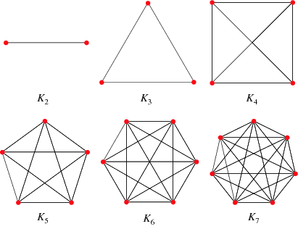
Complete Graph
A simple undirected graph in which every pair of distinct vertices is connected by a unique edge.

Slide 36
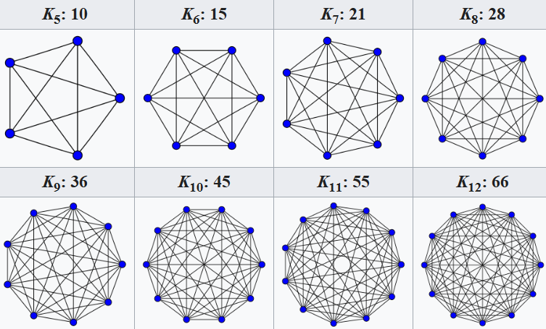
K5 through K12

